Slide 1
Employing Machine Learning for Performance-Based Compensation in College Football

Slide 2

Problem Statement
What's the Issue?
Right now, all college football teams in our conference get the same amount of money, no matter how well they play.
Our data shows that teams are really different in how many yards they gain and how many touchdowns they score. This means some teams are doing a lot more to win games than others, but they're all getting paid the same.
What We Found with the Data →
By looking at the numbers, like the ones from the K-Means clusters, we see some teams (like those in Cluster 0) are making big plays and scoring a lot, while others (in Cluster 1) are not.
Why This Matters →
If we keep paying teams the same no matter what, the ones working hard to win might feel it's not worth it. And the ones not doing as well don't have a big reason to try harder.
We think that teams should get paid based on how well they play. That way, every team has a reason to do their best, which makes the games more exciting and the whole conference stronger.
Our Solution →
We want to use machine learning, which is a smart way to look at all the data and figure out who's playing well and who's not.
We can use the numbers from our dataset to decide how much money each team should get. This way, the teams that help the conference shine will get more.
The Big Picture →
Changing to a pay system that looks at how teams actually perform is more fair and will help all teams to keep getting better.

Slide 3
Business Understanding
Why Aligning Pay and Performance Matters →
It's like getting a bonus at work. When football teams know they'll get paid more for scoring more points and winning more games, they have a bigger reason to play harder and better.
This approach makes sure that teams who put in the effort to be stars on the field get the rewards they deserve.
Impact on Team Behavior →
With a performance-based pay system, every team will want to be in the top spots. This means coaches will train their players harder, players will push themselves more, and the games will get more exciting.
Teams that might not have done much before will start to step up, knowing that there’s more money at stake.
Improving the Conference’s Reputation →
When teams are fighting to outdo each other, it makes our conference more popular. Fans love watching teams that play to win, and that brings in more people to the stadiums and more viewers on TV.
This popularity can lead to bigger sponsorship deals, more merchandise sales, and increased funding for all the teams.
Financial Health of the Conference →
With better performances, the conference makes more money. This isn't just good for the top teams; it's good for everyone because it means the conference can invest in better facilities, training, and maybe even scholarships.
Think of it like a snowball effect – the better each team does, the bigger and better the conference gets, and the more everyone benefits.
The End Goal →
By connecting money to how teams perform, we're not just changing numbers; we're building a culture of excellence. We're telling every team that their hard work will pay off, and we're setting up our conference to be one of the best out there.

Slide 4
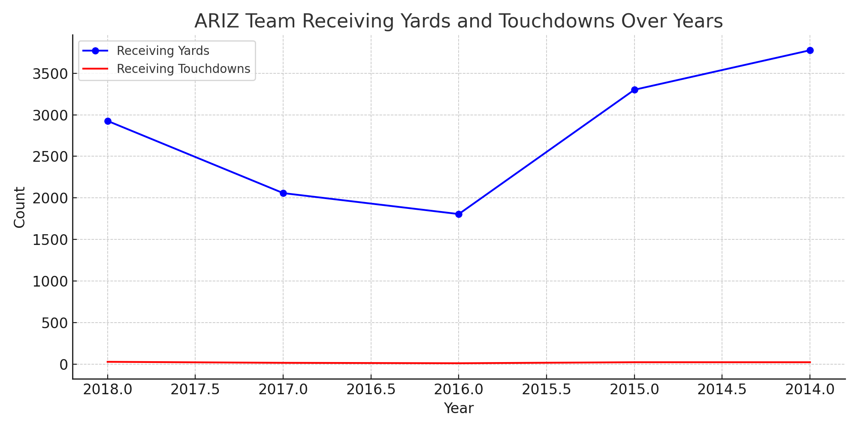
Data Understanding
Introduction to the Dataset →
Our dataset is a comprehensive collection of college football statistics from recent years. Each row is packed with performance data for a single team in a given year.
Crucial Performance Metrics →
Among many metrics, we're focusing on some key ones:
Receiving_sum_Yds: Total yards gained by receivers, a strong indicator of offensive strength.
Receiving_sum_TD: Total receiving touchdowns, a clear measure of scoring ability.
Defense_sum_Int: Interceptions by the defense, reflecting the team's defensive capabilities.
Insights from Data →
The data shows us not just how many points a team scores but also how they score them and how they defend against other teams.
For example, a team like ARIZ in 2018 had a total of 2,926 receiving yards and 29 receiving touchdowns, indicating a strong offensive play.
Year-over-Year Trends →
We see fluctuations in performance, such as increases or decreases in yards or touchdowns from year to year. This could be due to changes in team strategy, player rosters, or coaching staff.
Inter-Team Comparisons →
Comparing these stats across different teams helps us understand who the consistent high performers are and who might be underperforming.
Beyond the Surface Data →
Advanced metrics like averages and longest plays (e.g., "Recieveing_Max(Lg)") give us a deeper insight into the nature of each team's gameplay—whether they rely on long, breakout plays or consistent, shorter gains.
Potential for Deeper Analysis →
With machine learning, we can dive even deeper to predict future performance, identify key factors in winning games, and create profiles for similar teams.

Slide 5
Data Preparation
Introduction to Data Preparation →
Before we could analyze the data, we needed to make sure it was clean and standardized. This means we had to organize and adjust the data so that our machine learning algorithms could work effectively with it.
Initial Data Cleaning →
We started by loading the dataset and selecting key features relevant to our analysis: 'Receiving_sum_Yds' (total receiving yards), 'Defense_sum_Yds' (total defense yards), and 'Recieveing_sum_TD' (total receiving touchdowns).
We ensured that we only worked with rows that had complete data for these features by dropping any rows with missing values.
Feature Selection →
The chosen features were selected based on their potential impact on a team's performance. By focusing on these metrics, we aimed to capture aspects of both offensive and defensive play.
Standardization of Features:
To ensure each feature contributed equally to the analysis, we applied standard scaling. This process transformed our selected features so they had a mean of 0 and a standard deviation of 1.
This step is crucial because it prevents features with larger scales from dominating the analysis, allowing the algorithm to uncover true patterns in the data.
Clustering Preparation:
With the data cleaned and standardized, we applied K-Means clustering to segment the teams into groups based on similarities in their performance metrics. The algorithm identified distinct clusters, revealing patterns that weren't immediately obvious.
For K-Means, we specified 3 clusters and set a random state for reproducibility.
Insight and Action:
Through this preparation, we were able to not only cluster the teams effectively but also calculate the silhouette score, a measure of how similar an object is to its own cluster compared to other clusters. This helped us understand the appropriateness of the clustering.
Takeaway Message:
Data preparation was a foundational step in our analysis, enabling us to transition from raw data to actionable insights. It set the stage for us to explore relationships within the data and propose a performance-based compensation model grounded in objective metrics.

Slide 6
Modelling - K-Means Clustering
Introduction to K-Means Clustering:
K-Means is a popular machine learning algorithm used for clustering. It groups data into a specified number of clusters, in this case, teams with similar performance metrics.
Choosing the Number of Clusters:
We decided on 3 clusters for our analysis. This choice was made considering the diversity in performance across teams and the need to strike a balance between too many clusters (overfitting) and too few (under-generalization).
Application to Football Data:
We applied K-Means clustering to our standardized dataset, focusing on 'Receiving_sum_Yds' and 'Recieveing_sum_TD’,Defense_sum_Yds as key features. These metrics were chosen because they represent significant aspects of a team's offensive performance.
Results of Clustering:
The clustering process grouped teams into three distinct categories based on their offensive and Defensive performance :
Cluster 0: Teams with high receiving yards and touchdowns, indicating strong offensive gameplay.
Cluster 1: Teams with moderate performance, showing potential but not at the top tier.
Cluster 2: Teams that might be struggling offensively, with lower yards and touchdowns.
Insights Gained:
This segmentation allows us to understand team performances more deeply. For example, teams in Cluster 0 might be considered the offensive powerhouses of the conference, potentially driving more fan engagement and revenue.
Silhouette Score:
The silhouette score for our K-Means model was 0.304, suggesting moderate cluster separation. While there's room for improvement, it indicates that the clusters we identified have some degree of distinctness.
Strategic Implications:
By identifying these patterns, we can tailor strategies for each cluster. High-performing teams (Cluster 0) could be leveraged for marquee matchups to drive viewership, while teams in Clusters 1 and 2 might benefit from targeted development programs to enhance their performance.

Slide 7
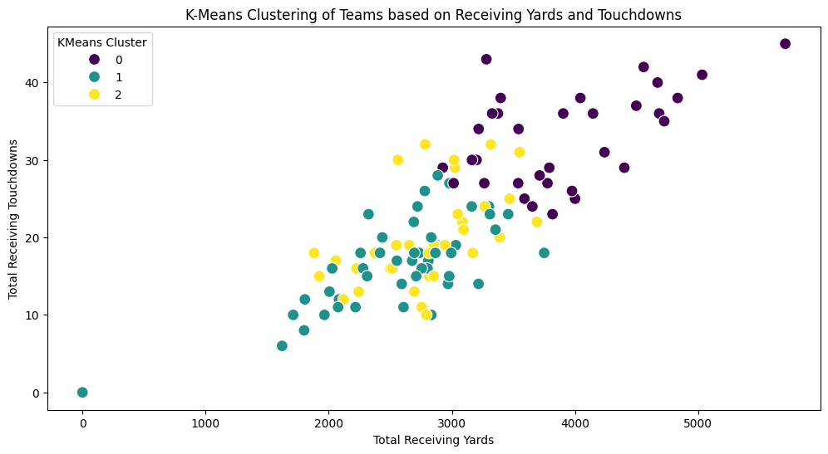
Output →
Detailed K-Means Clustering Insights and Tailored Recommendations:
Cluster 0 Insights:
- Average Receiving Yards: 3908.70
- Average Defensive Yards: 161.42
- Average Receiving Touchdowns: 32.79
Tailored Recommendations for Cluster 0:
- Maintain strong offensive strategies; explore options to enhance defense.
Cluster 1 Insights:
- Average Receiving Yards: 2542.56
- Average Defensive Yards: 111.54
- Average Receiving Touchdowns: 16.46
Tailored Recommendations for Cluster 1:
- Balanced approach required; focus on both offense and defense.
Cluster 2 Insights:
- Average Receiving Yards: 2784.14
- Average Defensive Yards: 276.66
- Average Receiving Touchdowns: 19.86
Tailored Recommendations for Cluster 2:
- Defensive improvements needed; consider defensive coaching and player development.

Slide 8
Modelling - Agglomerative Clustering
Understanding Agglomerative Clustering:
Agglomerative Clustering is a type of hierarchical clustering method that builds a tree of clusters by successively merging pairs of clusters. This approach starts with each team as its own cluster and then combines them step by step based on their similarities.
Process of Hierarchical Clustering:
In our analysis, we used 'ward' linkage to minimize the variance when merging clusters. This method considers the entire cluster when making decisions, ensuring a more balanced hierarchical structure.
Comparing with K-Means:
Unlike K-Means, which partitions the data into non-overlapping clusters (assuming spherical shapes), Agglomerative Clustering provides a more nuanced view by building a hierarchy of clusters. This can reveal more complex relationships and structures within the data.
Insights from Agglomerative Clustering:
Our Agglomerative Clustering model segmented teams into three groups, similar to K-Means, but with a focus on both offensive and defensive metrics:
Cluster 0: High offensive performance but moderate defensive metrics, suggesting these teams are strong but could improve on defense.
Cluster 1: Lower in both offense and defense, indicating these teams might be newer or in a rebuilding phase.
Cluster 2: Moderate offense with stronger defense, suggesting a more balanced or defensive strategy.
Silhouette Score Comparison:
The silhouette score for Agglomerative Clustering was 0.284, slightly lower than the K-Means score of 0.305. This indicates that while the clusters are reasonably distinct, there may be more overlap or less clear boundaries between clusters in Agglomerative Clustering.
Tailored Recommendations:
For teams in Cluster 0, the focus should be on maintaining their offensive power while bolstering defense.
Teams in Cluster 1 need a balanced development approach to enhance both offense and defense.
Cluster 2 teams should continue refining their defensive strategies while seeking ways to increase offensive output.

Slide 9
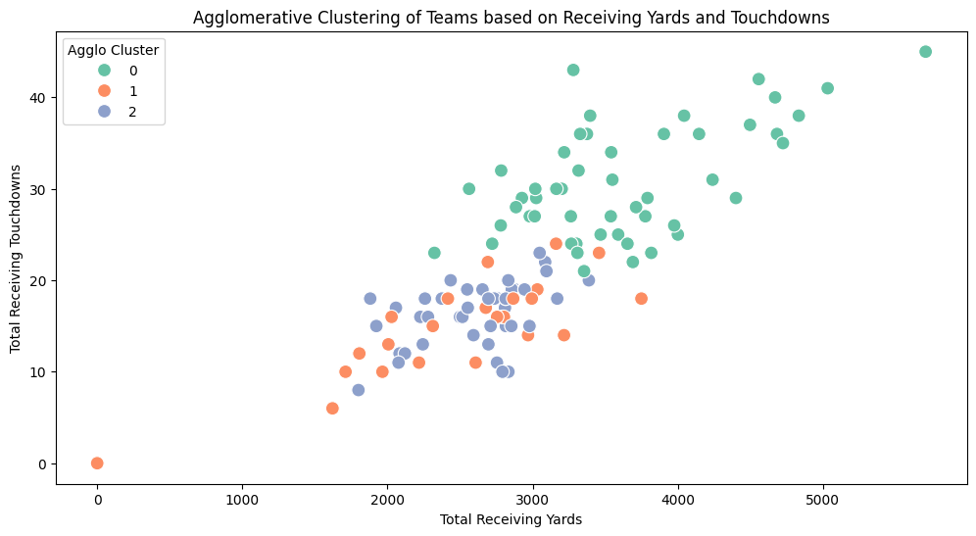
Output →
Agglomerative Clustering Silhouette Score: 0.2838946455938724
Detailed Agglomerative Clustering Insights and Tailored Recommendations:
Cluster 0 Insights:
- Average Receiving Yards: 3626.30
- Average Defensive Yards: 188.44
- Average Receiving Touchdowns: 30.66
- Maintain and enhance offensive strategies.
Cluster 1 Insights:
- Average Receiving Yards: 2414.89
- Average Defensive Yards: 71.48
- Average Receiving Touchdowns: 14.59
- Seek balance in team development; both offense and defense require attention.
Cluster 2 Insights:
- Average Receiving Yards: 2607.63
- Average Defensive Yards: 219.95
- Average Receiving Touchdowns: 16.42
- Focus on defensive training and strategy improvements.

Slide 10
Comparative Analysis
Overview of Models:
We employed two distinct clustering techniques, K-Means and Agglomerative Clustering, to segment the teams based on performance metrics. Each model offers a unique perspective on grouping teams with similar characteristics.
Silhouette Scores:
K-Means achieved a silhouette score of 0.304, indicating a moderate level of cluster definition.
Agglomerative Clustering produced a slightly lower silhouette score of 0.284, suggesting the clusters are less distinct than those identified by K-Means.
These scores help us gauge the effectiveness of each clustering approach in distinguishing separate groups.
Interpretability and Insights:
K-Means provides a clear-cut, centroid-based grouping, making it straightforward to interpret and apply. For instance, Cluster 0 in K-Means, with high receiving yards and touchdowns, clearly identifies top offensive teams.
Agglomerative Clustering, being hierarchical, offers a nuanced view of team relationships and performance tiers. This method revealed, for example, that teams in Cluster 0 not only excel offensively but also have considerable defensive capabilities.
Actionable Insights:
Both models offer actionable insights, but their utility varies based on the context:
K-Means is beneficial for broad strategic decisions, such as identifying overall high performers (offensive powerhouses) for key matchups or promotional efforts.
Agglomerative Clustering provides deeper insight into the nuanced relationships between team performances, which can be invaluable for targeted development programs or in-depth competitive analysis.
Strategic Decision-Making:
The choice between K-Means and Agglomerative Clustering depends on the specific needs of the conference:
For clear segmentation and straightforward strategies, K-Means is preferable.
When a more detailed understanding of team performance hierarchies is needed, Agglomerative Clustering offers greater depth.

Slide 11
Evaluation
Introduction to Evaluation Metrics:
In clustering analysis, especially where the true labels are unknown, it's crucial to have reliable metrics to evaluate the model's performance. One such metric we employed is the silhouette score.
Understanding Silhouette Score:
The silhouette score is a measure of how similar an object is to its own cluster compared to other clusters. The value ranges from -1 to +1, where a high value indicates that the object is well matched to its own cluster and poorly matched to neighboring clusters.
In the context of our models, the silhouette scores provide an objective measure of the cohesion and separation of the clusters formed by K-Means and Agglomerative Clustering.
Implications of Silhouette Scores:
For K-Means, a silhouette score of 0.304 suggests moderate cohesion within clusters and separation between them, indicating a reasonable grouping of teams based on their performance metrics.
The Agglomerative Clustering model's silhouette score of 0.284 also indicates a fair level of distinction among clusters, albeit slightly lower than K-Means. This difference might reflect the hierarchical nature of Agglomerative Clustering, which can capture more complex relationships at the cost of some cluster purity.
Guiding Decision-Making:
These metrics are not just abstract numbers; they have practical implications for conference management. For example, clusters with high silhouette scores are likely to represent genuine groupings of similar teams, which can be targeted for specific policies, marketing strategies, or development programs.
Conversely, lower scores might indicate areas where the clustering model could be improved or suggest inherent complexities in team performances that warrant a more nuanced approach.
Continuous Improvement:
Evaluation metrics like the silhouette score also serve as a benchmark for iterative model improvement. By adjusting parameters, adding new features, or even trying different models, we can aim to enhance these scores, leading to more accurate and useful cluster formations.
Concluding Thought:
The use of evaluation metrics, particularly the silhouette score, is fundamental in validating the quality of our clustering models. These insights not only affirm the models' reliability but also empower the conference with data-driven strategies to elevate the competitive landscape and operational efficiency.

Slide 12
Deployment and Recommendations
Strategic Deployment of Insights:
The clustering analysis has segmented teams into distinct groups based on performance metrics. This categorization forms the basis of our recommendations for a more nuanced compensation strategy, directly tying financial incentives to performance and contribution levels.
Tailored Compensation Framework:
High-Performing Clusters (e.g., Cluster 0 in K-Means): Teams in these clusters have shown exceptional offensive capabilities and could be considered the conference's flag bearers. We recommend premium compensation for these teams, coupled with performance bonuses for maintaining high standards.
Mid-Level Performers (e.g., Cluster 1 in Agglomerative Clustering): Teams here are competitive but not at the top. A balanced compensation strategy with clear performance-based milestones can motivate these teams to level up.
Developing Teams (e.g., Cluster 2 in both models): These teams might be struggling in certain areas. Targeted financial incentives for specific improvements, like defensive strategies or offensive yard gains, could foster growth and competitiveness.
Dynamic Compensation Adjustments:
Instead of a static model, the conference should adopt a dynamic compensation framework that can evolve based on annual performance data. This ensures that the compensation model remains fair, competitive, and reflective of the current landscape.
Supportive Measures:
Alongside financial compensation, the conference should consider support mechanisms for teams in lower clusters to help them improve. This could include coaching workshops, infrastructure investments, or player development programs, funded in part by the conference to elevate overall competitiveness.
Transparent Communication and Feedback Loop:
It's essential to maintain transparency with all member teams about how compensation is determined. Regular feedback sessions can help address concerns and adjust the model to better serve the conference's collective goals.
Evaluating Impact:
Post-implementation, the conference should closely monitor the impact of the new compensation model on team performance, fan engagement, and overall conference reputation. Adjustments should be made based on empirical evidence and stakeholder feedback.

Slide 13
Closing Remarks
Reiterating the Value Proposition:
Our proposal leverages advanced machine learning techniques to dissect and understand team performance in unprecedented ways. By employing K-Means and Agglomerative Clustering, we've unearthed patterns and segments within the conference that traditional analysis might overlook.
Innovative Use of Machine Learning:
The strategic application of machine learning, particularly clustering algorithms, marks a significant innovation in how sports organizations can approach performance evaluation and compensation. This data-driven methodology transcends subjective assessments, providing an objective basis for critical financial decisions.
Strategic Benefits for the Conference:
Competitive Excellence: The proposed compensation model, informed by our clustering analysis, promises to ignite a new level of competition among teams, driving them towards higher performance levels.
Financial Health and Sustainability: By aligning financial rewards with performance, the conference not only ensures fairness but also enhances its appeal to sponsors, broadcasters, and fans, securing its financial future.
Adaptability and Growth: This approach allows the conference to remain dynamic, adjusting to changes within the sport and maintaining its leadership position. The continuous application of machine learning insights ensures that strategies stay relevant and effective.
Parting Thought:
By adopting this proposal, the conference doesn't just change its compensation model; it transforms its very ethos to one that celebrates and rewards excellence, innovation, and fairness. This shift is not merely about financial redistribution but about elevating the game of football to new heights, ensuring a vibrant, competitive, and sustainable future for all involved.

Slide 14
THANK YOU !

